Slide 1
HOME CREDIT DEFAULT RISK
Take Home Assessment
Zankhana Mehta

Slide 2
Content structure
1
Problem Statement
2
Dataset Overview
3
Methodology
4
Exploratory Data Analysis
5
Baseline Model
6
Feature engineering
7
Model Training & Evaluation
8
Conclusion
9
References

Slide 3
Problem statement
Goal
Business context
Challenge
Predict whether a loan applicant is likely to default on their payment.
Improve risk-based loan pricing
Reduce losses and improve approval quality
Imbalanced data
Heterogeneous client profiles
Multiple Data sources

Slide 4
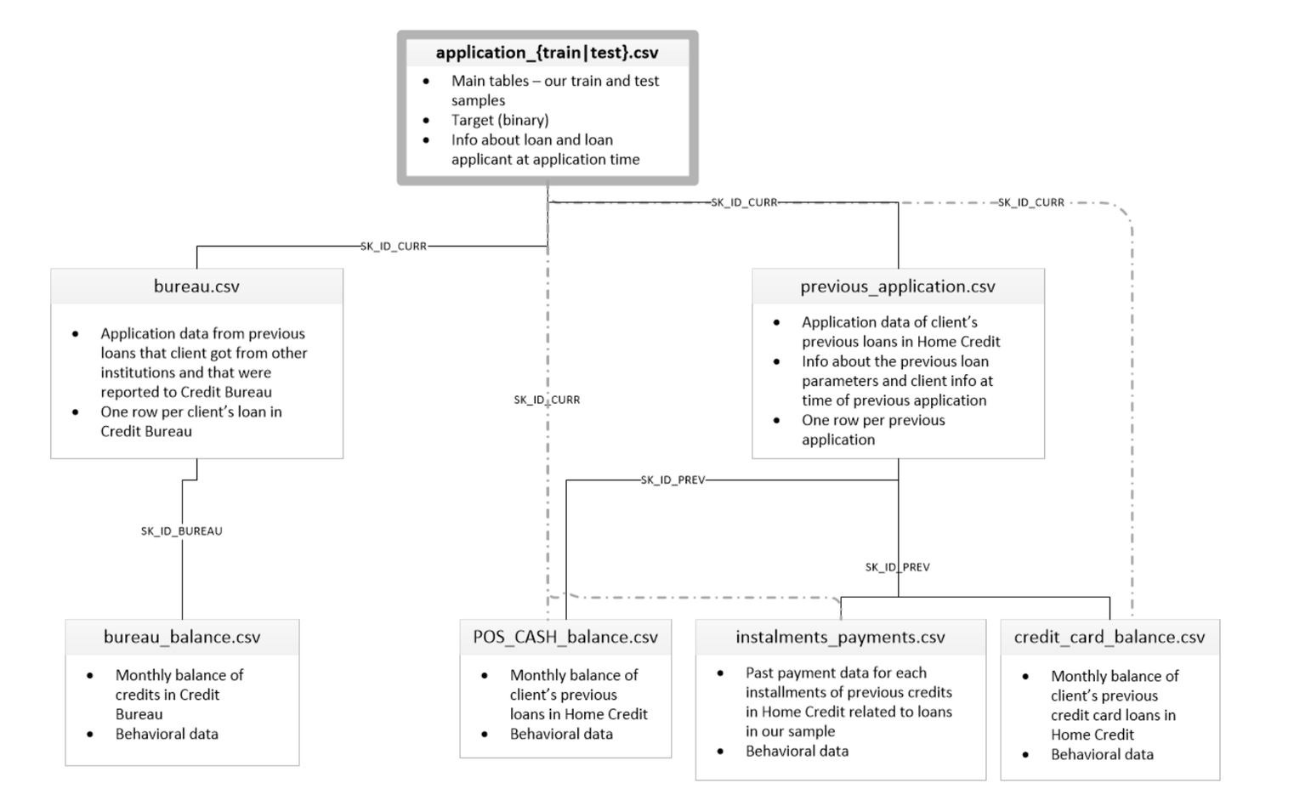
Dataset Overview
Main Dataset: application_train.csv (~307,000 records, 122 features)
Target Variable: TARGET → 1 = default, 0 = non-default
Additional Datasets (external sources): bureau.csv, previous_application.csv, POS_CASH_balance.csv, credit_card_balance.csv, installments_payments.csv
Test Set: application_test.csv (~48,000 records, no TARGET)
Meta Data: HomeCredit_columns_description.csv provided field-level descriptions

Slide 5

Methodology
1
2
3
4
Exploratory Data Analysis
Baseline Modeling
for Benchmark
Data Preprocessing/ Feature Engineering
Advanced Modeling & Evaluation
Analyzed target distribution
Used training set for initial analysis and baseline modelling
Basic pre-processing steps
Trained Random Forest, XGBoost, CatBoost, and LightGBM
Identified key risk indicators using visualizations
Merged auxiliary tables
Applied different optimization approaches

Slide 6
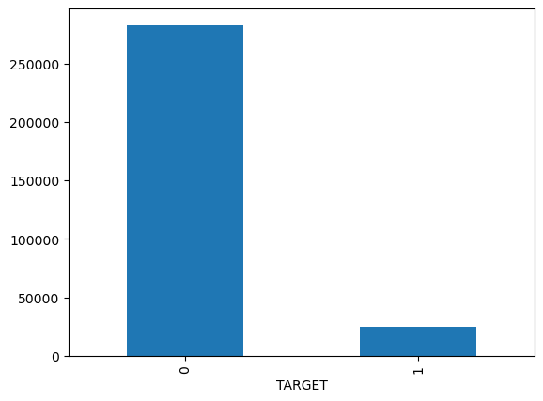
Exploratory data analysis(EDA)
Numerical Feature Insights
Income-related features (AMT_INCOME_TOTAL, AMT_CREDIT, etc.) are right-skewed
High missing values in housing-related features (APARTMENTS_AVG, YEARS_BUILD_*)
DAYS_EMPLOYED contains anomalous placeholder value (365243) → indicates unemployment
Categorical Feature Insights
Majority loan type: Cash loans
More female applicants than male; rare 'XNA' entries in gender
Most applicants: Working, Married, with Secondary education, living in House/apartment
Common occupations: Laborers, Sales staff
Imbalance in TARGET: ~8% default rate

Slide 7
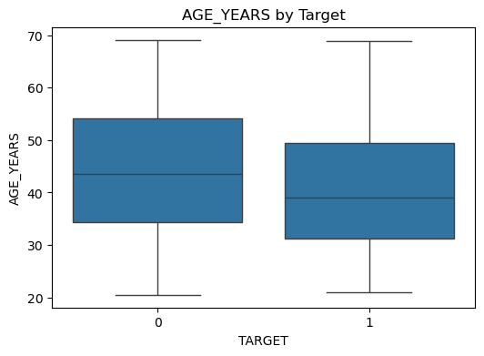
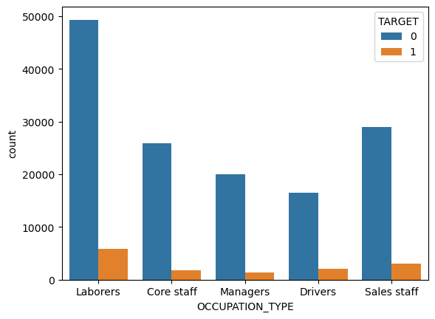
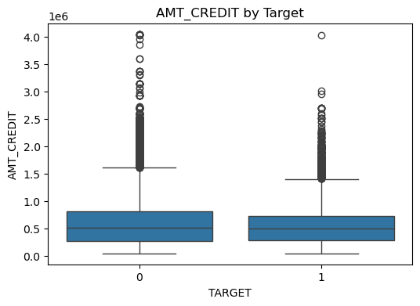
Exploratory data analysis (EDA)
Bivariate Relationships
Defaulters are generally younger
Higher default rates among specific job types (e.g., low-skill laborers)
Defaulters often take out lower to medium loans

Slide 8
Baseline model
Data Loading and Initial Cleanup
Feature Engineering
Model training and evaluation
Loaded data from: application_train.csv
Checked and summarized missing values
Dropped columns with >60% missing data
Numerical features: Imputed with median values
Categorical features: Imputed with mode
Ensured no remaining null values post-cleaning
Features like CREDIT_INCOME_RATIO, ANNUITY_INCOME_RATIO , CREDIT_TERM, EMPLOYED_BIRTH_RATIO
Label Encoding: Converted object-type categorical features into numeric using LabelEncoder
Final shape train (246008, 125), validation (61503, 125)
Trained 4 enseble models
ROC-AUC results
Random forest: 0.7119
XGBoost: 0.7646
LightGBM: 0.7641
CatBoost: 0.7589
XGBoost performs well than the others

Slide 9
Feature engineering
Data pre-processing
Aggregated data from other tables
Used SK_ID_BUREAU ,SK_ID_CURR as the keys to perform the joins.
Created domain-specific features:
CREDIT_TO_INCOME_RATIO, ANNUITY_TO_INCOME_RATIO
Used groupby().agg() combinations for numerical summarization
Final shape for train (307511, 167) and test (48744, 166)
Missing Values:
Dropped features with >60% missing
Imputed numeric features with median, categorical with mode
Removed low variance features:
Features with low variance do not help model learn much
Correlation analysis:
Removed features with high correlation
Re-aligned train and test columns
Final shape for train (307511, 90) and test(48744, 89)

Slide 10
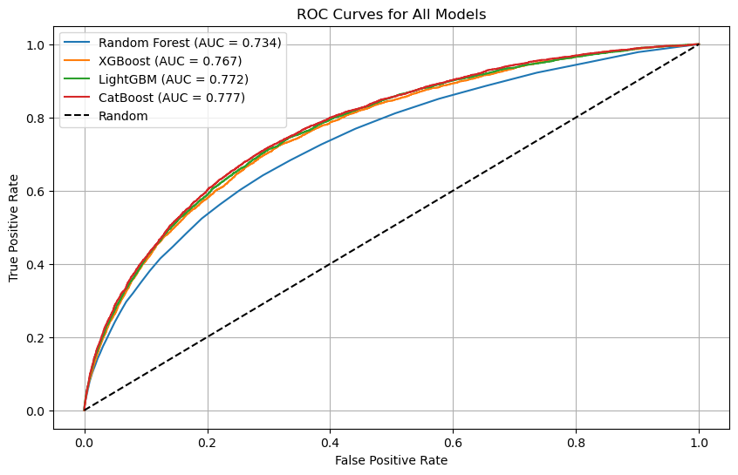
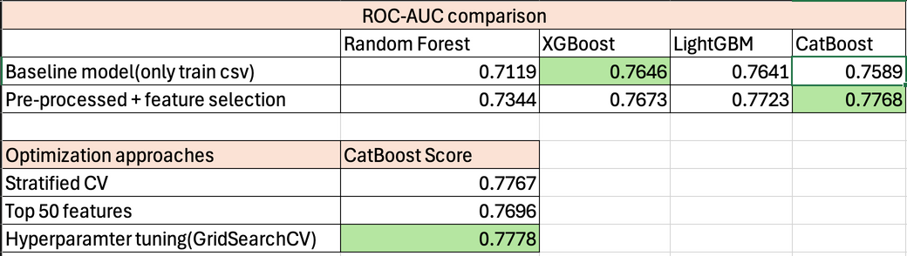
Model training and Evaluation
Models Tried:
Random Forest
XGBoost
CatBoost (Best performer)
LightGBM
Evaluation Metric: Prescision, Recall, F1 score,ROC AUC
Validation: StratifiedKFold (5-fold)
Optimization approaches: Stratified CV, Training on top 50 features, Hyperparameter tuning using GridSearchCV

Slide 11
Conclusion
1. Performance Improved with Preprocessing + Feature Selection: All models improved after applying proper preprocessing (handling missing values, encoding), feature engineering (ratios, aggregations) and feature selection (based on importance and correlation)
2. CatBoost Achieved the Best Overall ROC AUC: Even though XGBoost performed best in the baseline, CatBoost outperformed all others after full preprocessing and optimization.
3. Optimization slightly Boosted Performance: This also confirmed the model is sensitive to tuning and that using all important features is better than truncating too early.

Slide 12
References
Github link: https://github.com/zankhana46/Home-Credit-Default-Risk
Kaggle Dataset: https://www.kaggle.com/competitions/home-credit-default-risk/overview
Starter Notebook for reference: https://www.kaggle.com/code/sutariyasmit01/home-credit-default-risk

Slide 13
THANK YOU!

